Slide 1
Unit 2
Lecture 1
Inheritance in java, Overriding, Use of super, Abstract class, Interfaces, Packages, Importing packages, Exception handling in java, Use of try, catch, finally, throw in exception handling. Multithreaded programming, Thread life cycle, Thread priorities, Thread synchronization

Slide 2
Inheritance in Java is a cornerstone of object-oriented programming (OOP), allowing one class to acquire the properties and behaviors of another. It promotes code reusability, extensibility, and polymorphism—making your programs cleaner and more modular.

Slide 3
Key Concepts of Inheritance
Superclass (Parent Class): The class whose properties are inherited.
Subclass (Child Class): The class that inherits from the superclass.
extends Keyword: Used to establish inheritance.
Method Overriding: Subclass can redefine methods of the superclass.
"is-a" Relationship: Inheritance should reflect a logical hierarchy (e.g., Dog is an Animal).

Slide 4
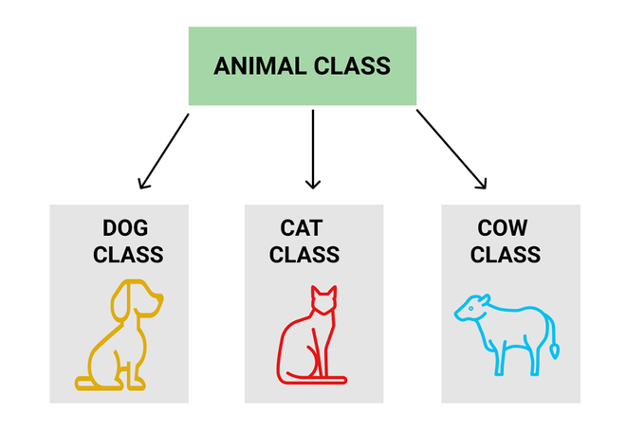

Slide 5
class ChildClass extends ParentClass
{
// Additional fields and methods
}

Slide 6
class Animal { void sound() { System.out.println("Animal makes a sound"); } } class Dog extends Animal { void sound() { System.out.println("Dog barks"); } } class Cat extends Animal { void sound() { System.out.println("Cat meows"); } } public class Main { public static void main(String[] args) { Animal a; a = new Dog(); a.sound(); // Output: Dog barks a = new Cat(); a.sound(); // Output: Cat meows } }
Notes:
Arrays of Objects in Java
An array of objects is created like an array of primitive-type data items
Example: Here we are taking a student class and creating an array of Student with five Student objects stored in the array. The Student objects have to be instantiated using the constructor of the Student class and their references should be assigned to the array elements.

Slide 7
Why Use Inheritance?
Code Reusability: Common logic lives in the parent class.
Extensibility: Add new features in child classes without modifying the parent.
Polymorphism: Enables dynamic method dispatch.
Abstraction: Hide implementation details and expose behavior.

Slide 8
Method overriding
Method overriding in Java is a feature that allows a subclass (child class) to provide a specific implementation for a method that is already defined in its superclass (parent class). This is a core concept of polymorphism and enables runtime polymorphism, where the method executed is determined at runtime based on the actual object type.

Slide 9
Method overriding
Key characteristics and rules of method overriding:
Inheritance:
Overriding requires an "is-a" relationship, meaning a subclass must inherit from a superclass.
Same Signature:
The overriding method in the subclass must have the exact same name, number and type of parameters, and return type (or a covariant return type) as the method in the superclass.
Access Modifiers:
The access modifier of the overriding method cannot be more restrictive than the overridden method. For example, a protected method in the superclass can be overridden as protected or public in the subclass, but not private.

Slide 10
Exceptions:
The overriding method can declare fewer or the same checked exceptions as the overridden method, or it can declare a subclass of the checked exceptions. It cannot declare new, broader checked exceptions.
final methods cannot be overridden:
Methods declared as final in the superclass cannot be overridden by subclasses.
static methods cannot be overridden:
static methods belong to the class, not an object, and therefore cannot be overridden. If a subclass defines a static method with the same signature as a static method in the superclass, it is called "method hiding," not overriding.
private methods cannot be overridden:
private methods are not inherited by subclasses and thus cannot be overridden.
@Override Annotation:
It is good practice to use the @Override annotation when overriding a method. This annotation helps the compiler verify that the method is indeed overriding a method from the superclass, preventing potential errors due to typos or incorrect signatures.
Method overriding

Slide 11
class Animal
{ public void makeSound()
{ System.out.println("Animal makes a sound."); }}
class Dog extends Animal
{
@Override
public void makeSound()
{ System.out.println("Dog barks."); }}
public class OverrideEg{
public static void main(String[] args)
{
Animal myAnimal = new Animal();
Animal myDog = new Dog(); // Polymorphism
myAnimal.makeSound(); // Output: Animal makes a sound. myDog.makeSound(); // Output: Dog barks.
(Overridden method is called) }}

